Slide 1
Big Data Programming Project : Hush-Hush Recruiter –Python Project
Team4
Amin Feli
Sandhya Tripathi
Disha Gayathri Umashankar
SRH Hochschule Heidelberg

Slide 2
Problem Statement: Hush_Hush_Recruiter_Project
Doodle seeks to automate its recruitment process by developing an in-house solution for candidate identification. The platform will evaluate candidates using data points like GitHub and StackOverflow activity, notifying shortlisted individuals automatically. Shortlisted candidates will complete coding challenges via an interface, with their solutions evaluated by a Doodle hiring manager.

Slide 3
Table of Content
Identification and Selection of Data sources
Architecture Diagram
Selection Algorithm
HR manager’s console
Manager’s console
Candidate’s console
Email to candidate
Database
Conclusion
Future Scope
Resources

Slide 4
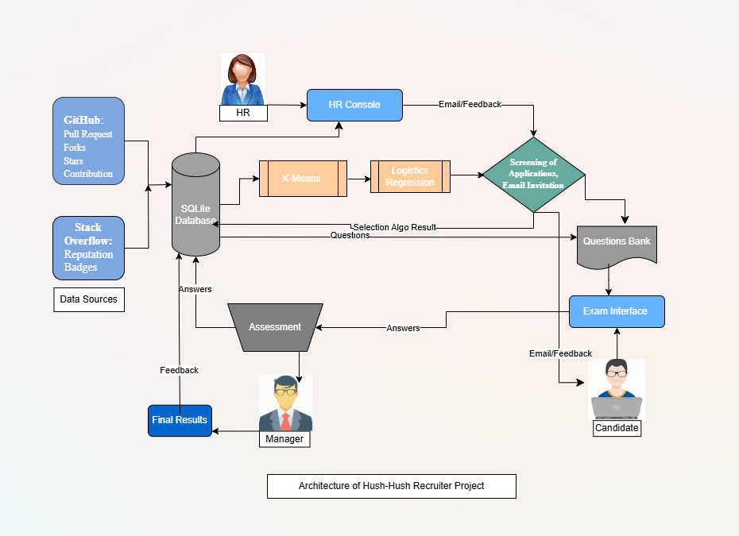
Architecture of Hush-Hush Recruiter

Slide 5
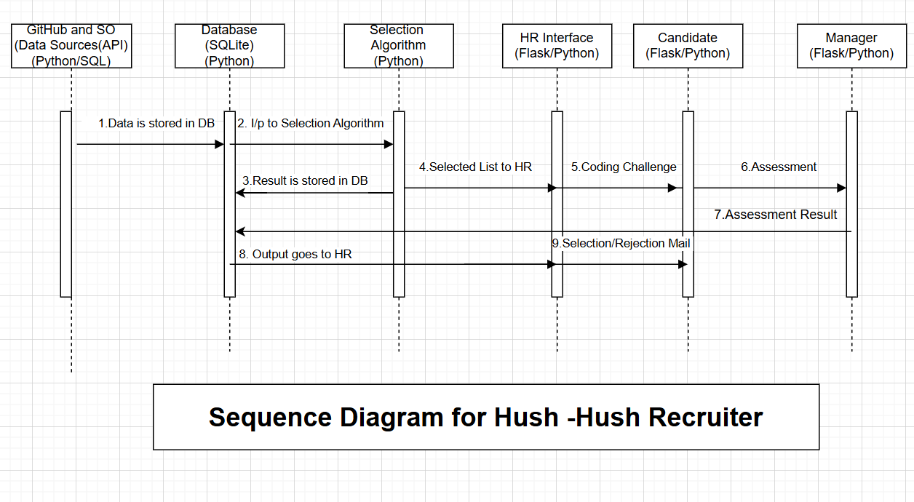

Slide 6


Data Sources

Slide 7
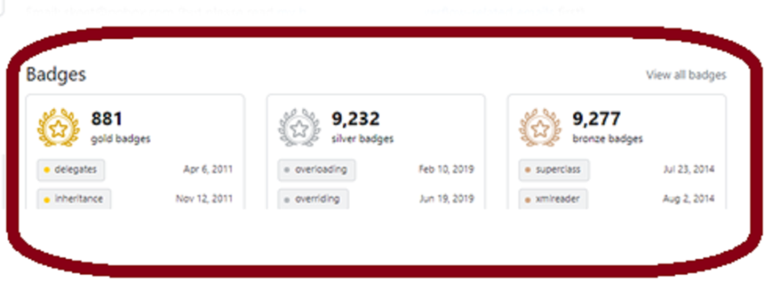
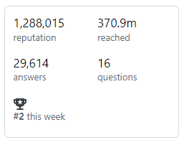
Data Sources:
Stack overflow:
Reputation & Badges are integral part of Rewards & Recognition(R&R) of platform
Reputation:
It represents user’s contribution & activity on platform. It consists of (upvotes/downvotes, accepted answers)
Badges:
Badges represents user activity and participation in three categories (Gold , Silver, Bronze)

Slide 8
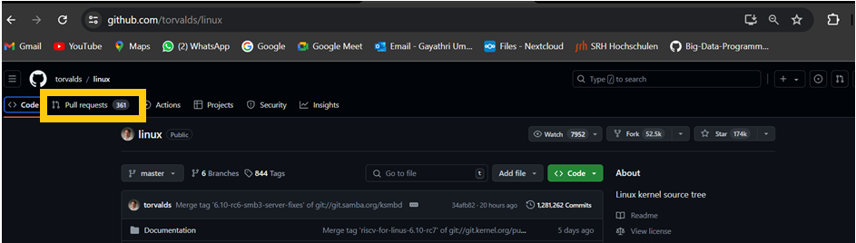
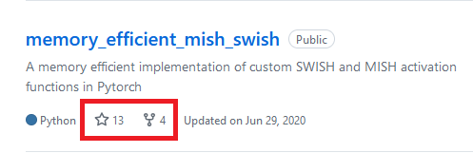
Data Sources:
Key Points:
GitHub: Pull requests, forks, stars, commit.
Pull Request (PRs):
Measures the candidate's contributions to various projects.
Indicates the ability to suggest and implement changes.
Forks:
The number of forks can indicate the reputation of the project.
Stars:
Represents the popularity and approval of the candidate's projects by the community.

Slide 9
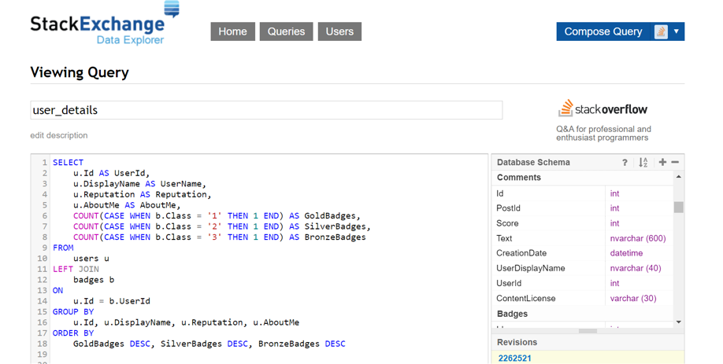
API( Stackoverflow)

Slide 10
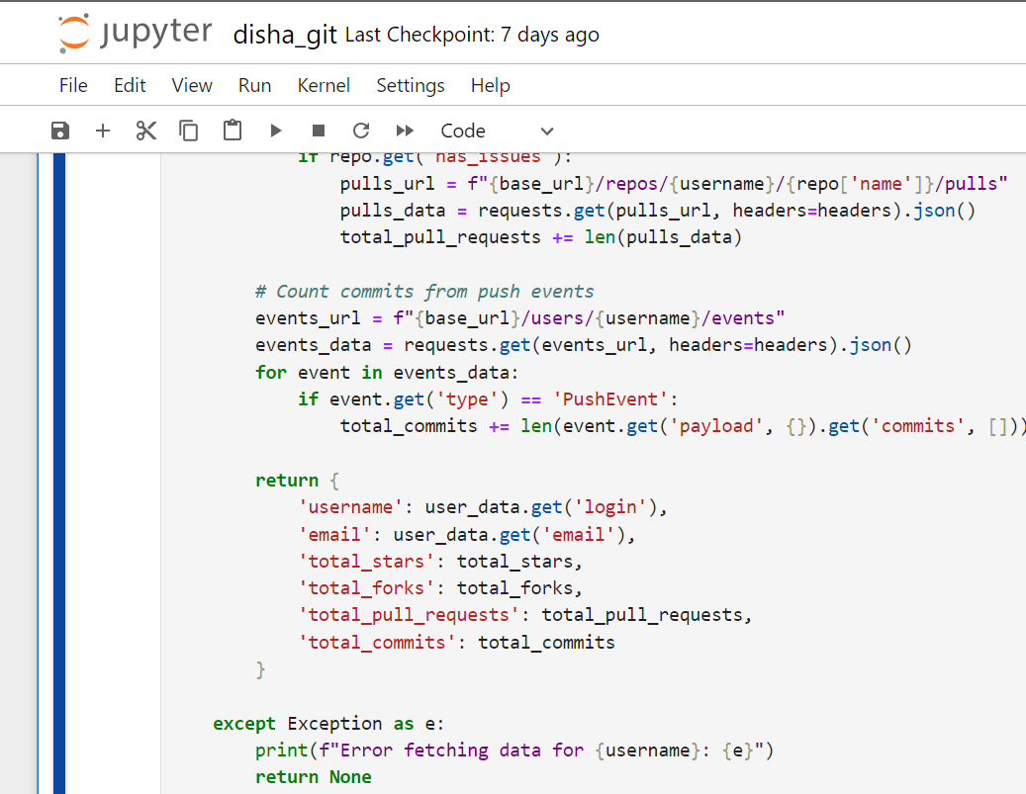
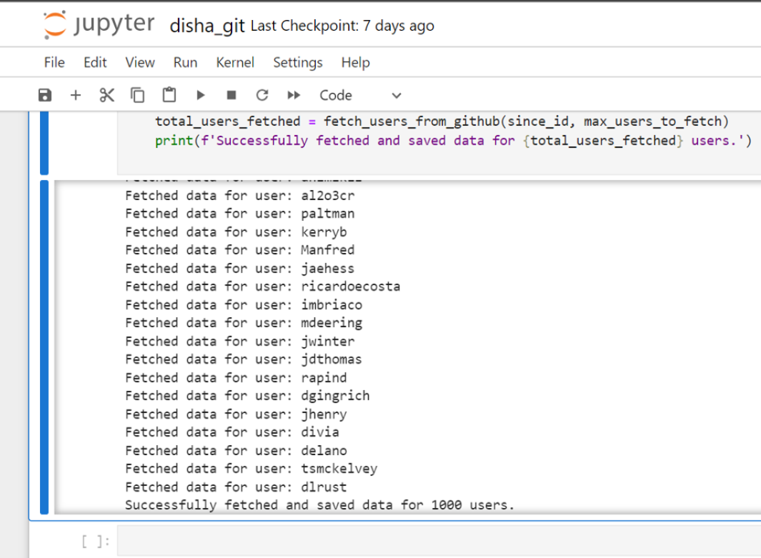
API(GitHub)

Slide 11
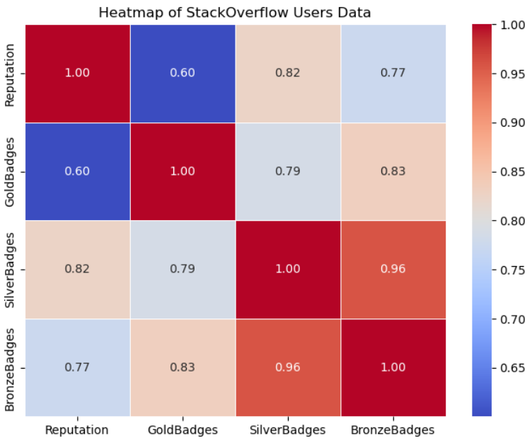
Heatmap_Stackoverflow

Slide 12
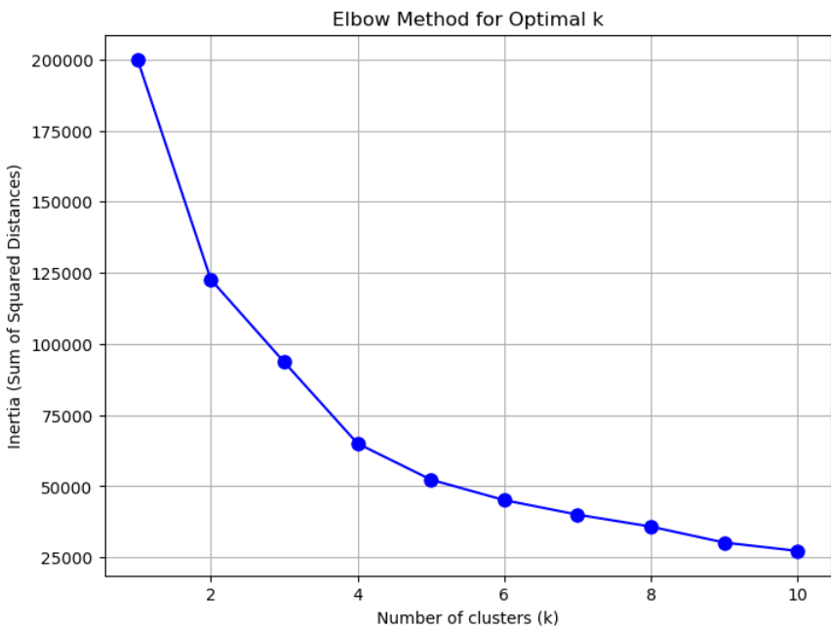
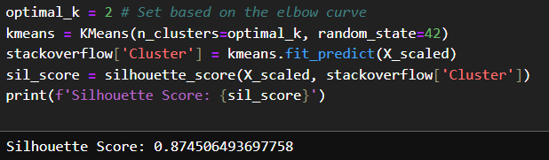
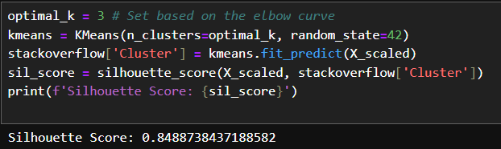
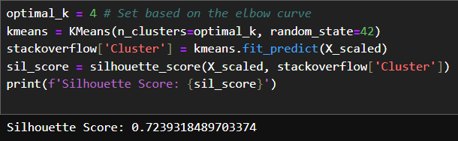
SK-Means Algorithm Result for k=2,3,4 with Silhouette Score(Stack_Overflow)

Slide 13
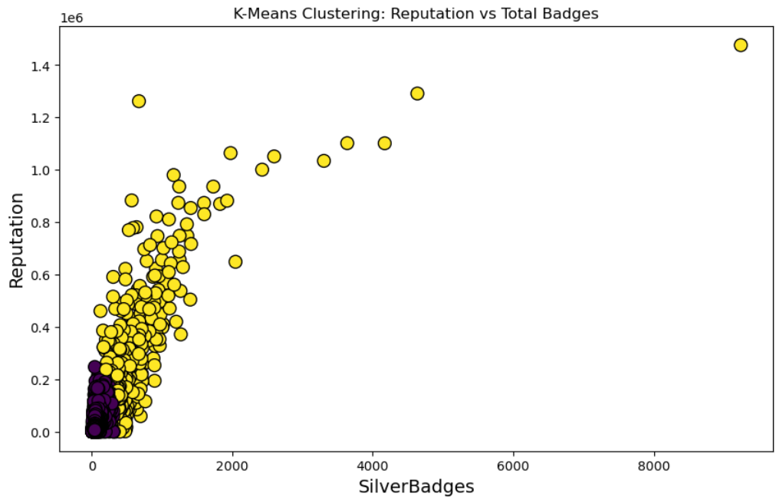
SK-Means Plot for k=2 (Stack_Overflow)

Slide 14
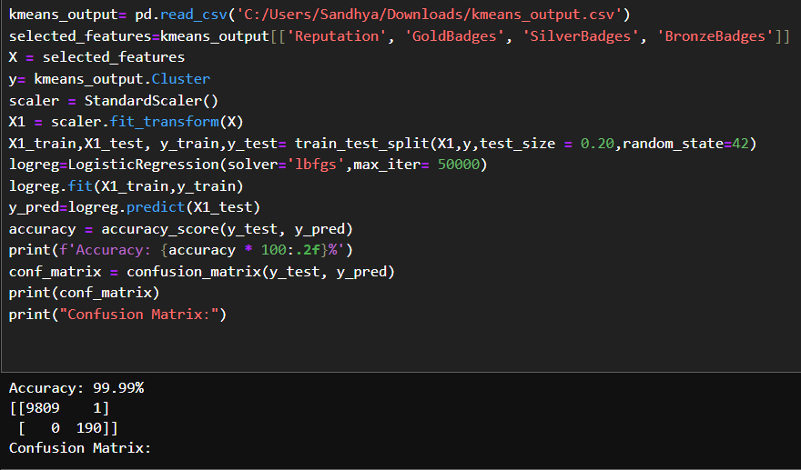
Logistic Algorithm (Stackoverflow)

Slide 15
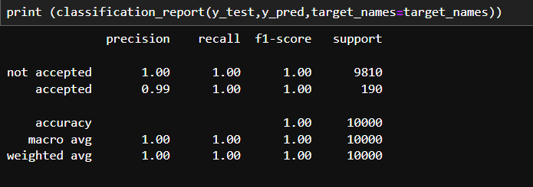
Classification_Report(Stackoverflow)

Slide 16
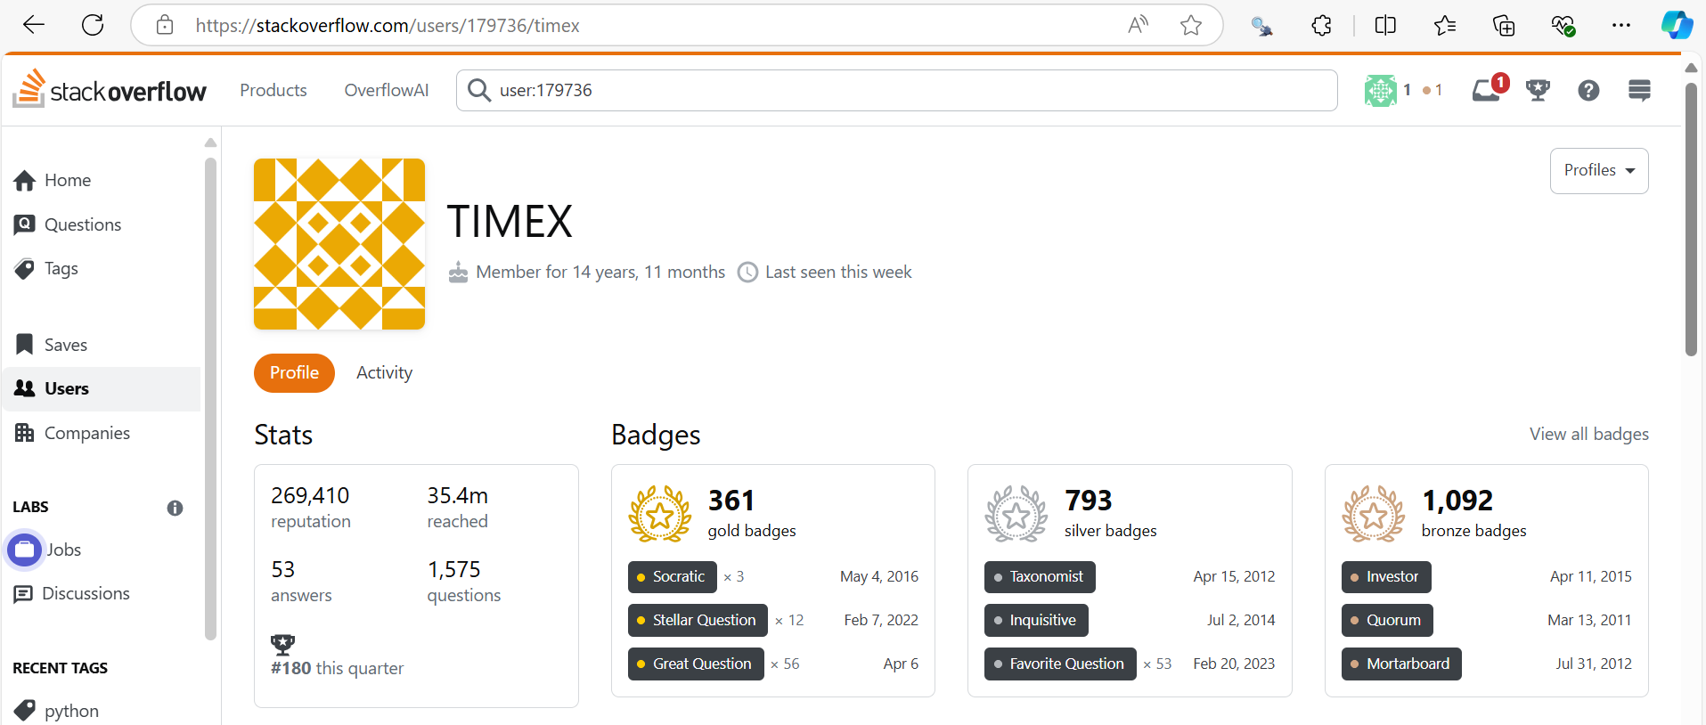
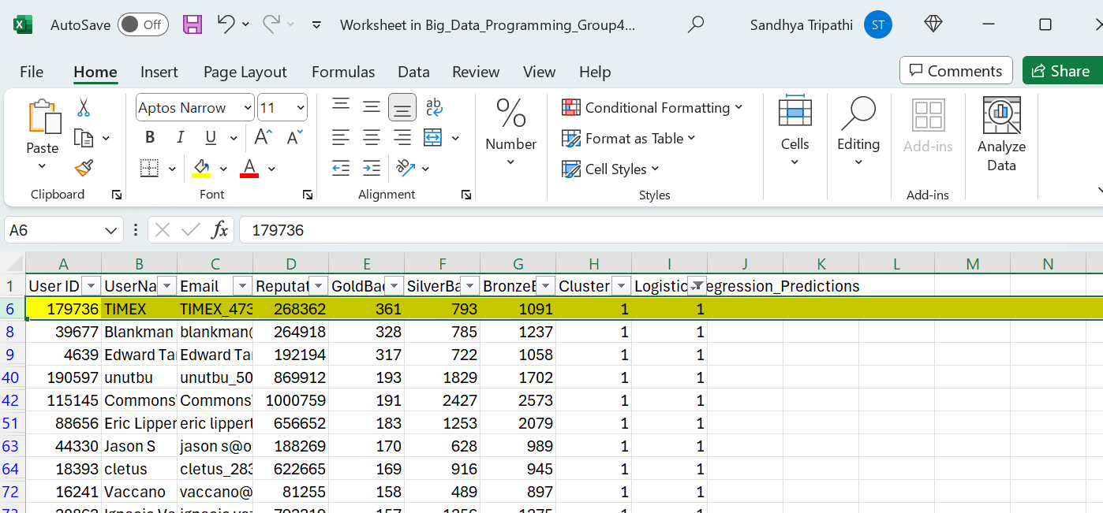
Output

Slide 17
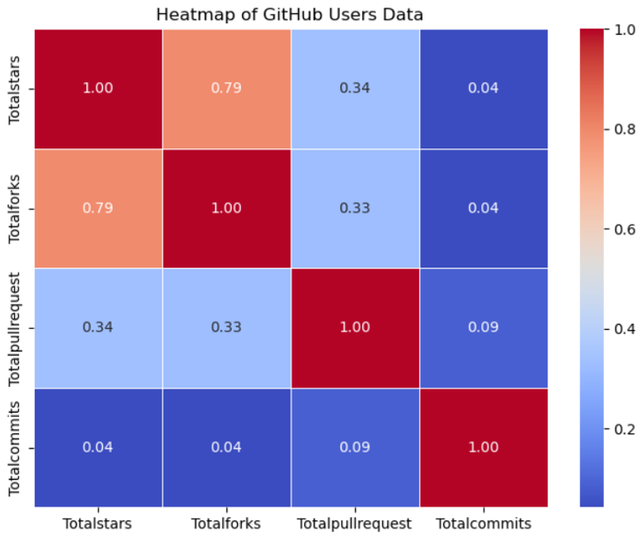
Heatmap_GitHub

Slide 18
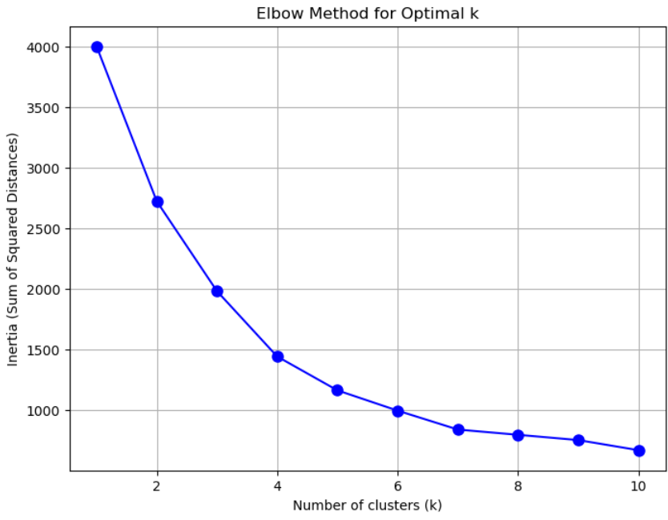
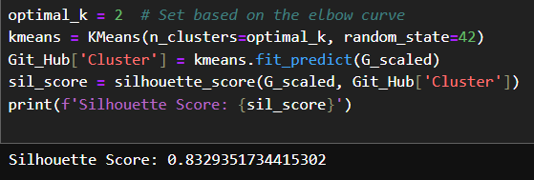
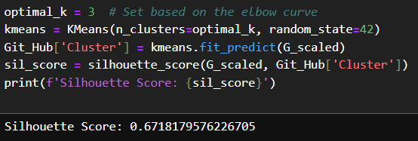
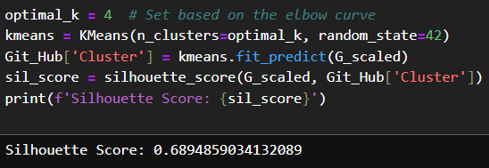
SK-Means Algorithm Result for k=2,3,4 with Silhouette Score(GitHub)

Slide 19
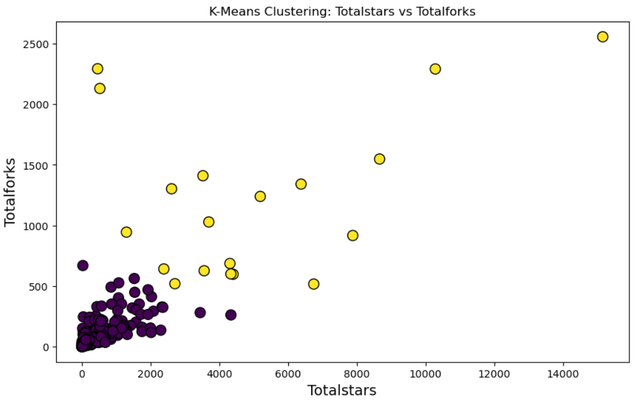
SK-Means Plot for k=2 (GitHub)

Slide 20
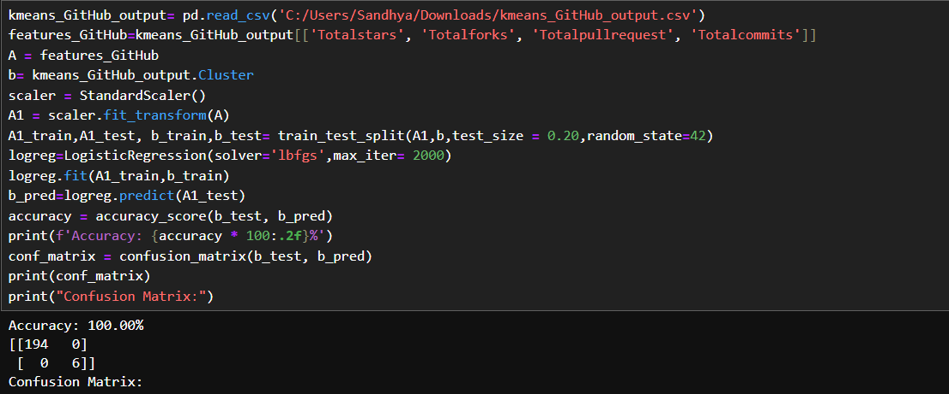
Logistic Algorithm (GitHub)

Slide 21
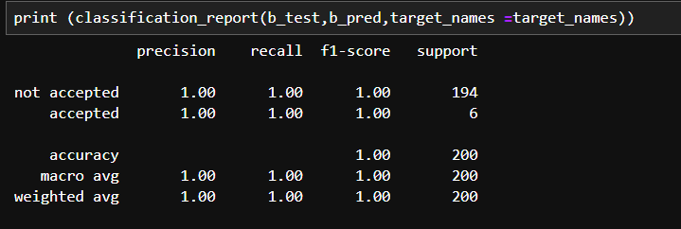
Classification_Report(GitHub)

Slide 22
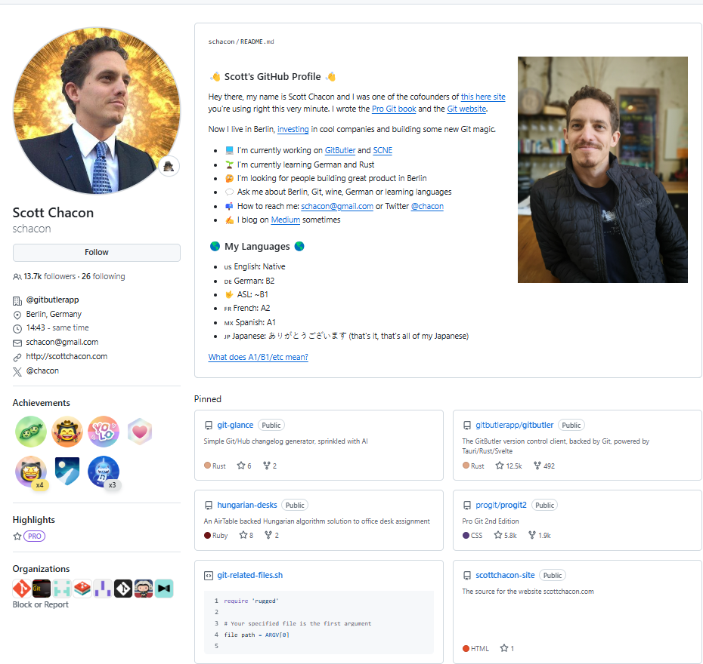
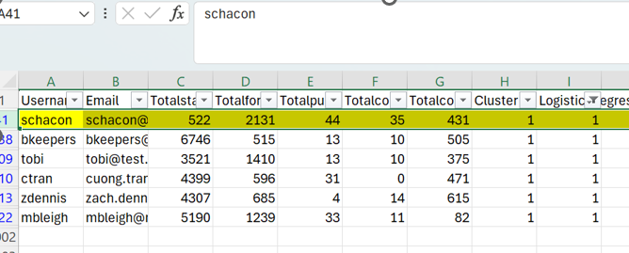
Output

Slide 23
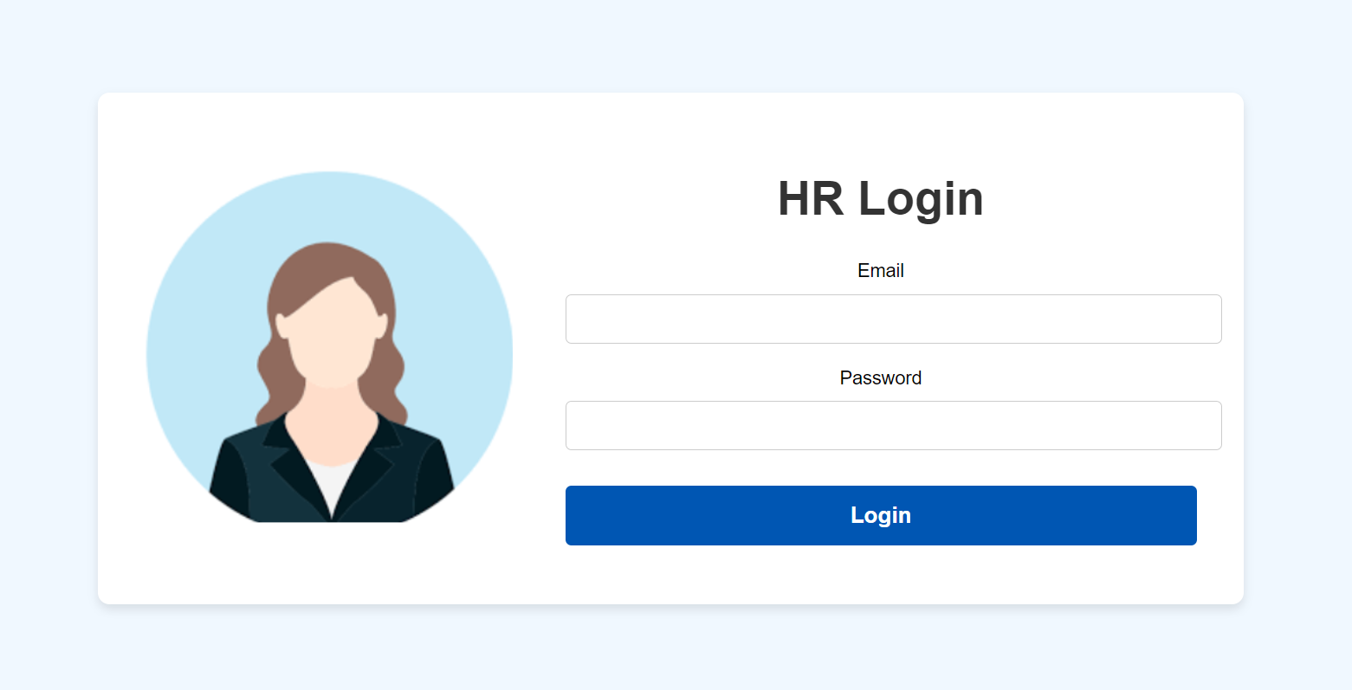
HR login Page

Slide 24

Candidate login Page

Slide 25

Manager login Page

Slide 26
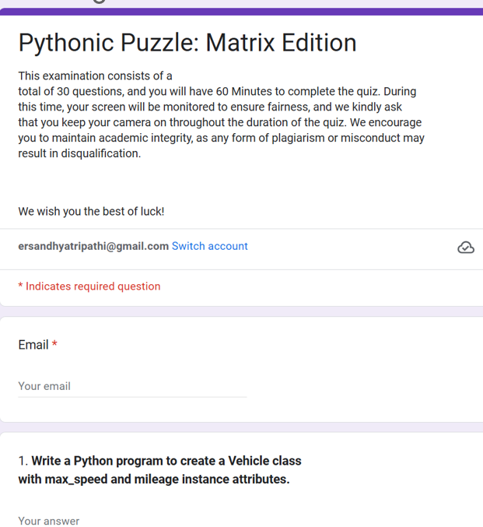
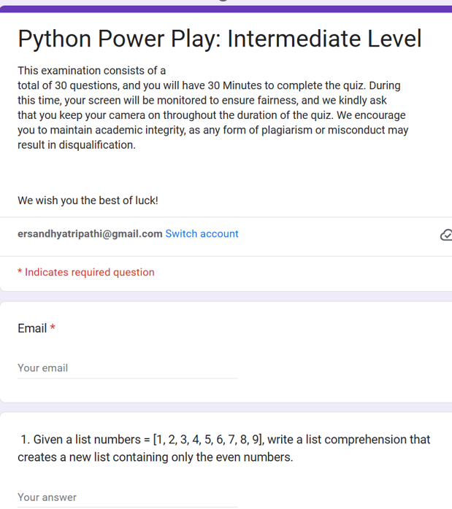
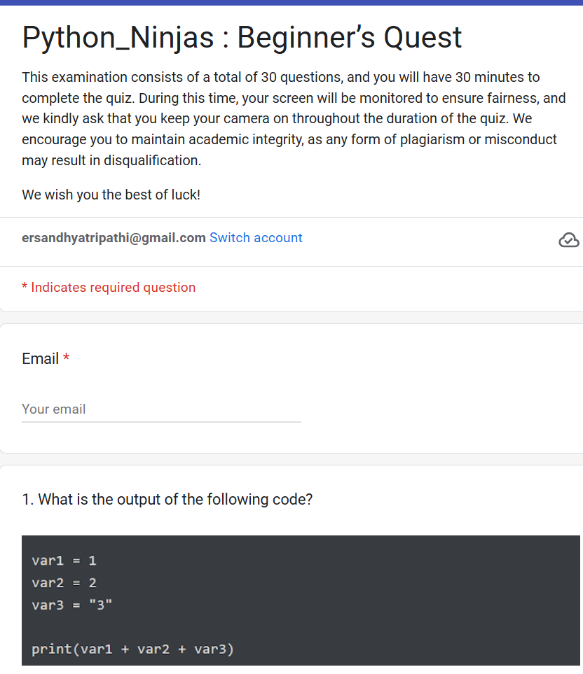
Google Forms: Matrix Edition/Power Play/Python Ninjas

Slide 27
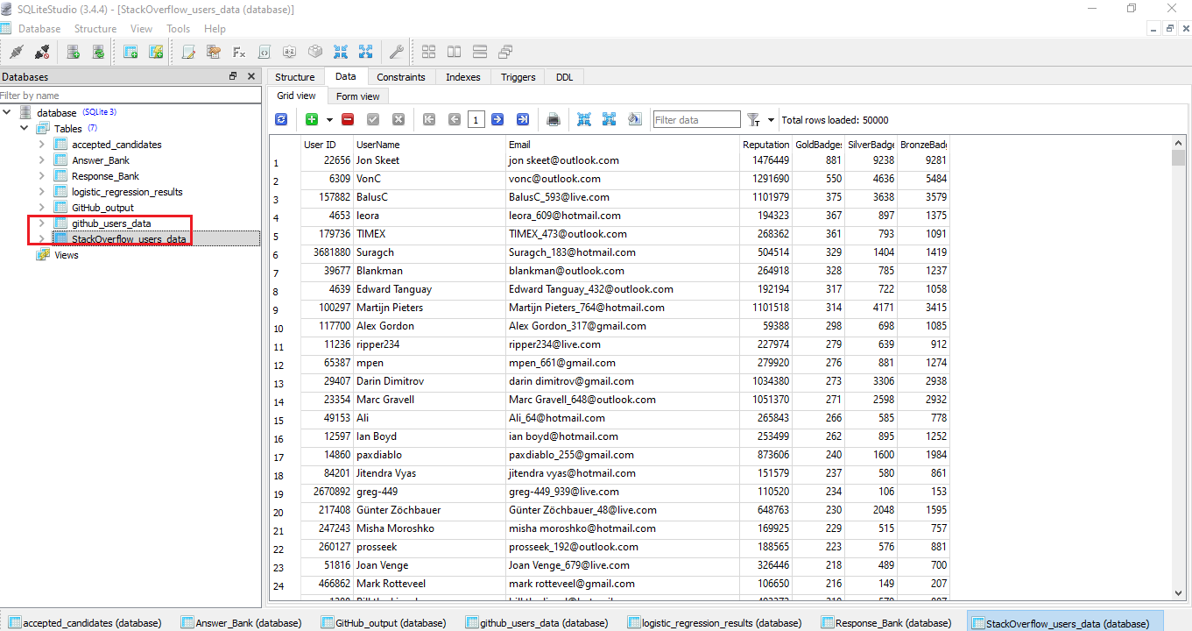
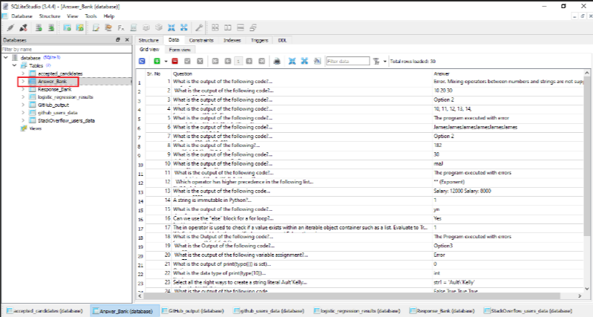
Database (Sqlite)

Slide 28
Conclusion
We have decided to go for 14 User stories for implementation of this project . 13 user Story have been completed by the Team however (Link Expiry-Submission Deadline) could not be implemented due to requirement of server based clock.

Slide 29
Learnings
API Timeout Error from GitHub which was handled by Sleep Command
Heatmap (only top row visible)…..( Updated the seaborn version to 0.13.2 print…all rows appeared on the Heatmap after version update
Decision of most appropriate parameters using Heatmap (Removal of Contribution from GitHub as Heatmap values were giving –ve results)
Trial with multiple algorithms and then selecting K-Means and logistics for selection of suitable candidates
Issue: As part of HR role, there is a requirement to send assessment invitations to candidates via email. However, the assessment interface and the corresponding link were hosted locally on the single (same ) machine, making them inaccessible from external devices or remote locations. As a result, candidates were unable to access the assessment link remotely.
Solution: To address this issue, Disha implemented Ngrok, a tool that creates a temporary public URL for locally hosted services. By utilizing Ngrok, the assessment link was accessible from any device, enabling candidates to complete the assessment remotely without any complications.

Slide 30
Further Improvements
Hosting of server based application
Unique Link that expire after a period of time​
Live automatic updates from GitHub and StackOverflow

Slide 31
References:
Scikit Learn
Draw.io
ChatGPT
GitHub
Stackoverflow
StackExchange
Flask
Youtube
Google
Notepad++
https://www.geeksforgeeks.org/​
https://docs.github.com/​

Slide 32




Kontakt:
Max Mustermann
SRH Holding (SdbR)
Bonhoefferstraße 1
69123 Heidelberg
T +49 6221 8223-0
info@srh.de
www.srh.de

